Slide 1
Charts for the Story File
File created on: 2/24/2023 7:49:17 PM

Slide 2
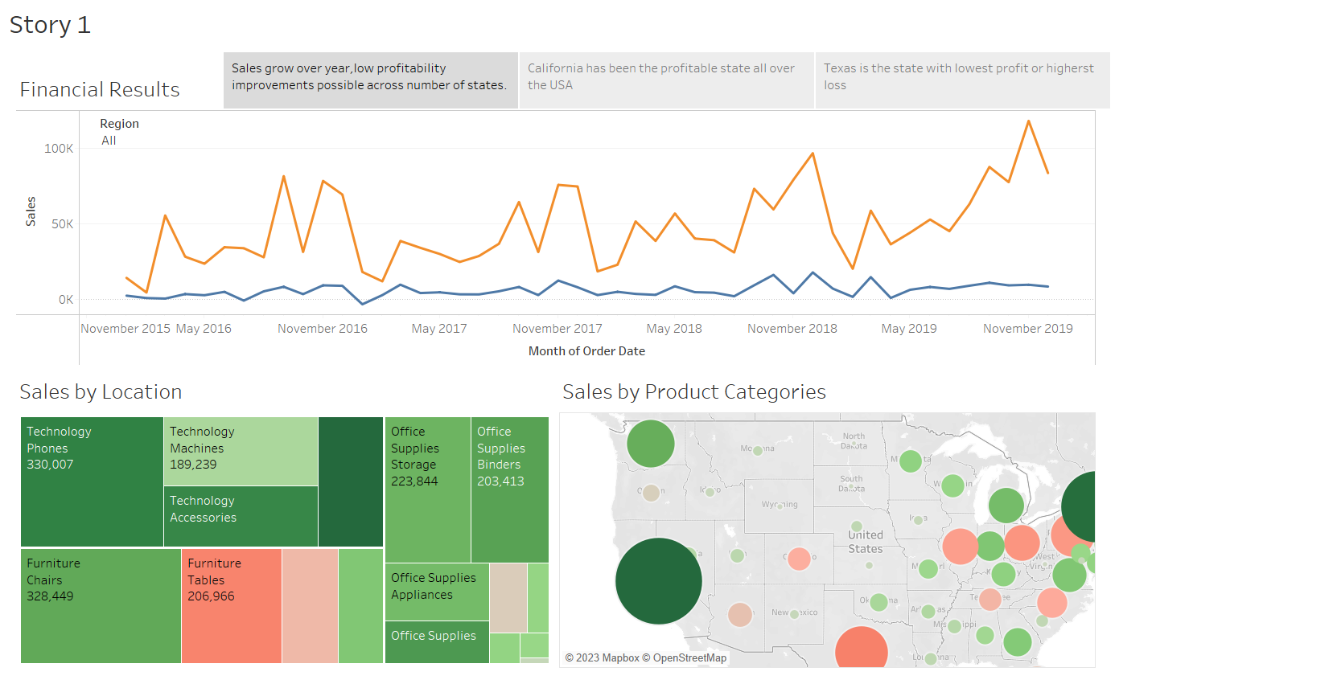

Slide 3
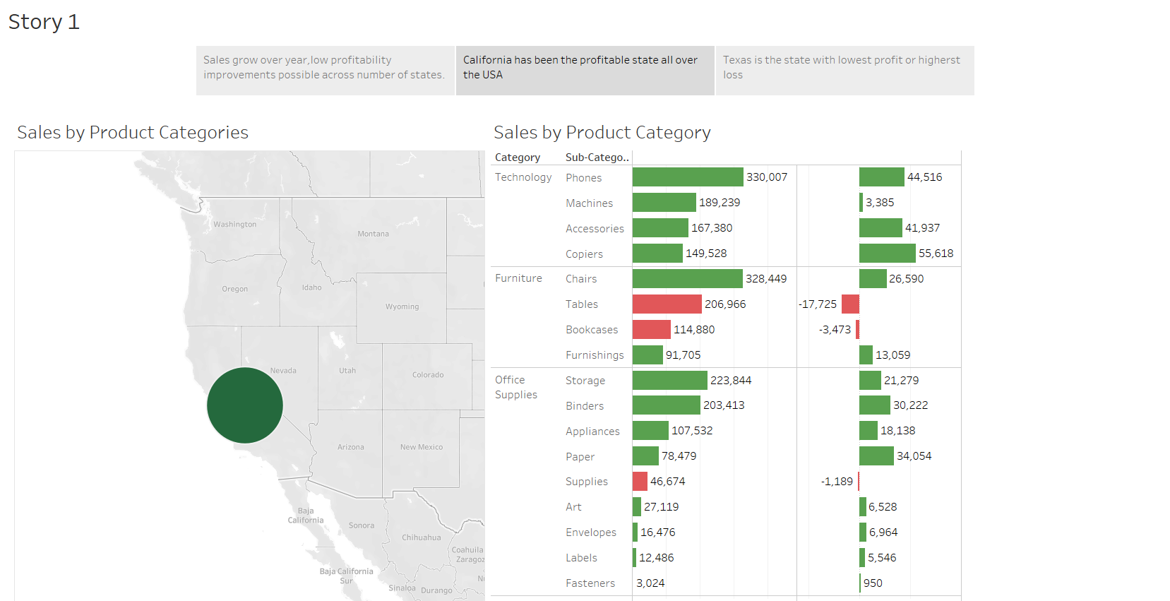

Slide 4
